Slide 1
Final Project: Smart Light
Evin Bour-Gilson & Noran Abdel-Aziz

Slide 2
Sensors & Actuators Used
IR Receiver
Receives infrared data transmissions from a remote control for user input
RGB LED
Provides visual feedback through different color indicators for user interactions
PIR Motion Sensor
Detects motion in the room to enable automatic light control, in turn enhancing energy efficiency
WS2812B Light Strip
Enables dynamic and customizable lighting effects, such as gradients, blinking, and brightness modification of the light
28BYJ-48 Stepper Motor & Driver Board
Physically turns on and off the light switch in the room corresponding with the WS2812B light strip

Slide 3
Program Implementation
Used python for application development
Libraries used:
aiocoap
asyncio
RPi.GPIO
gpiozero
datetime
board and neopixel
colorsys
Created a two python scripts
final.py: the main script running the server and functions on the Raspberry Pi
client.py: used to remotely control the smart light over WiFi using the CoAP protocol

Slide 4
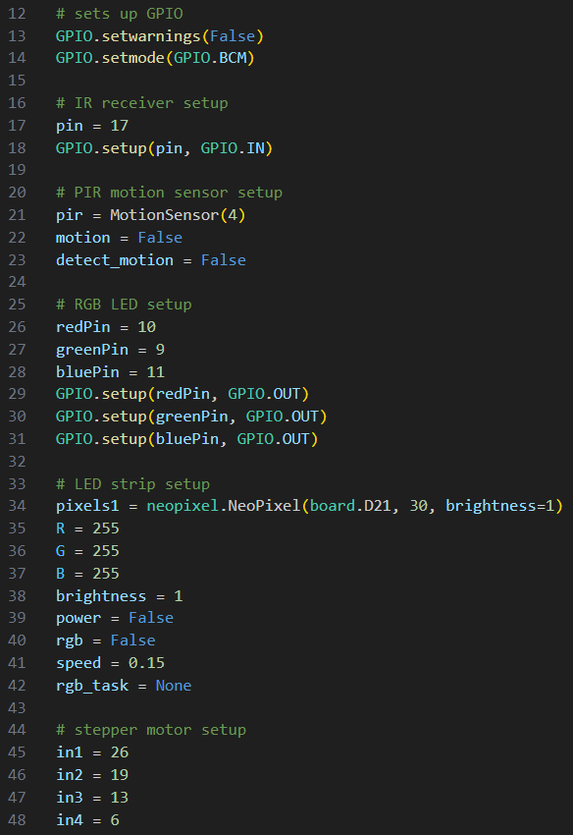
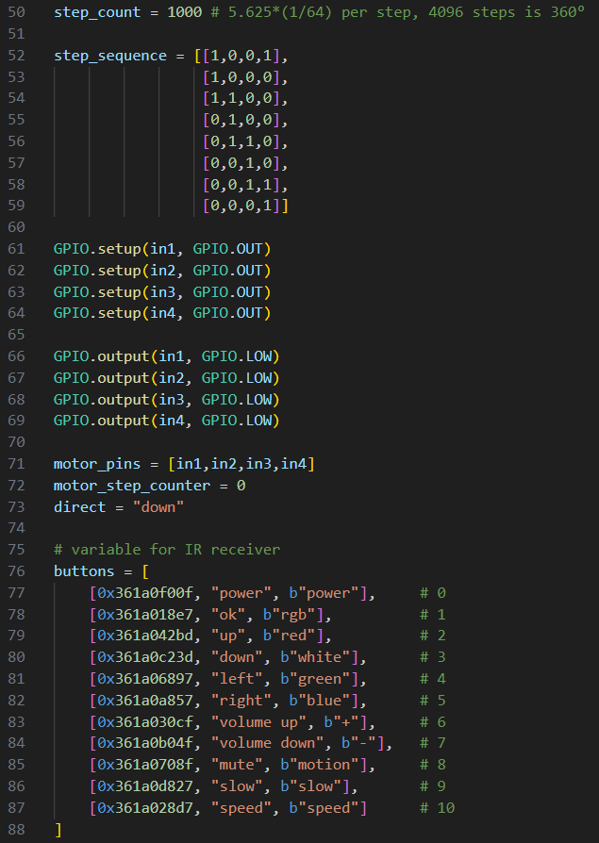
Code [GPIO & Program Setup]

Slide 5
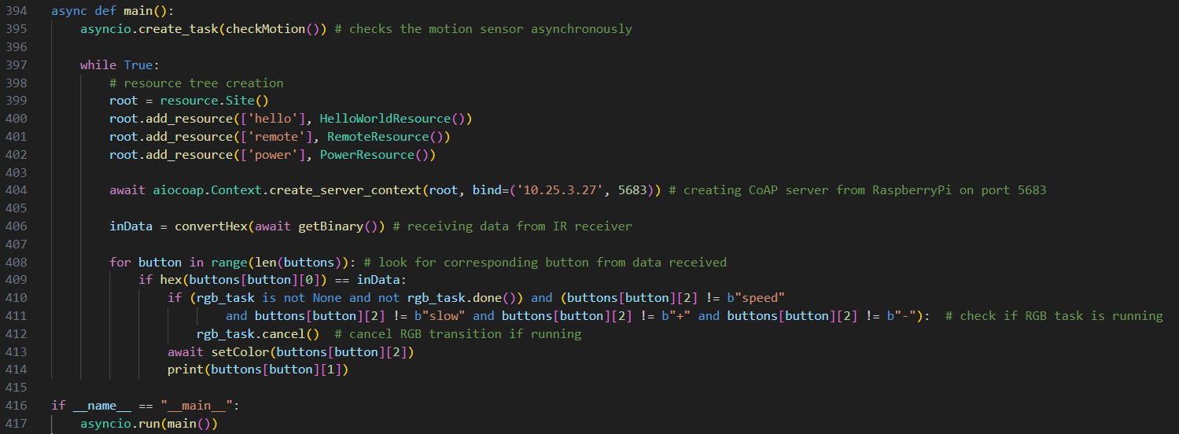
Code [Main]

Slide 6
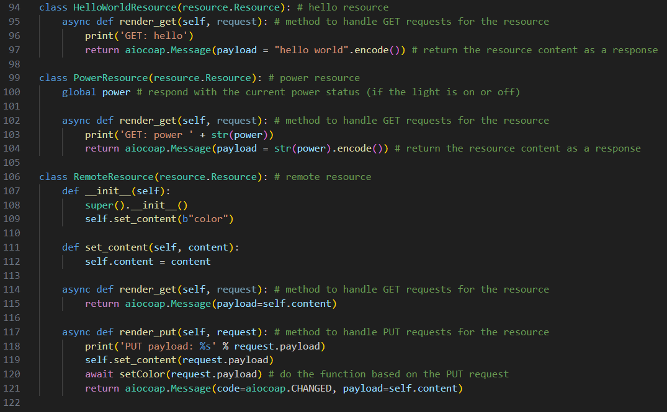
Code [CoAP Server]

Slide 7
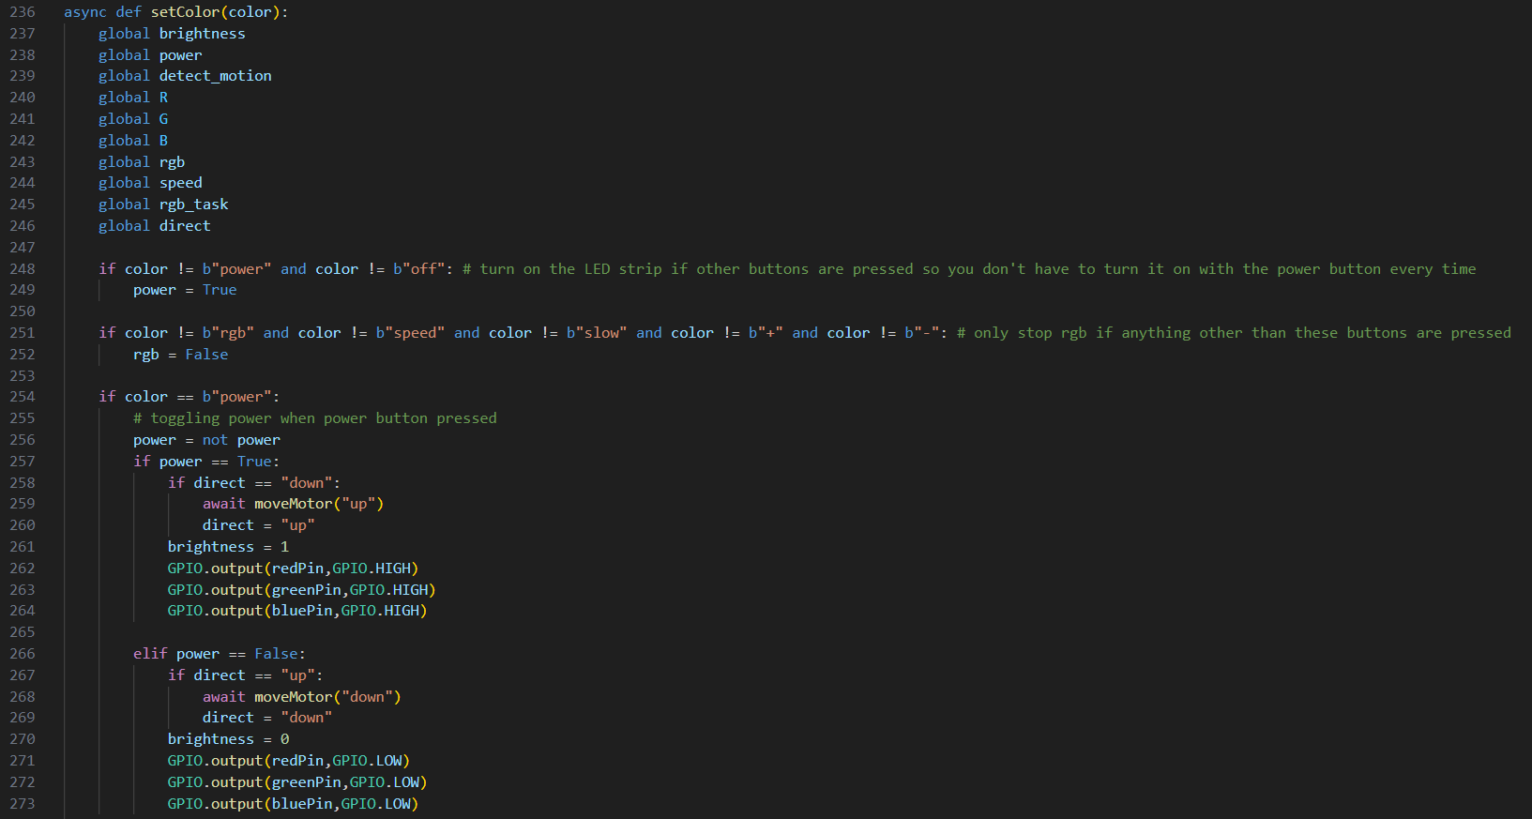
Code [setColor()]

Slide 8
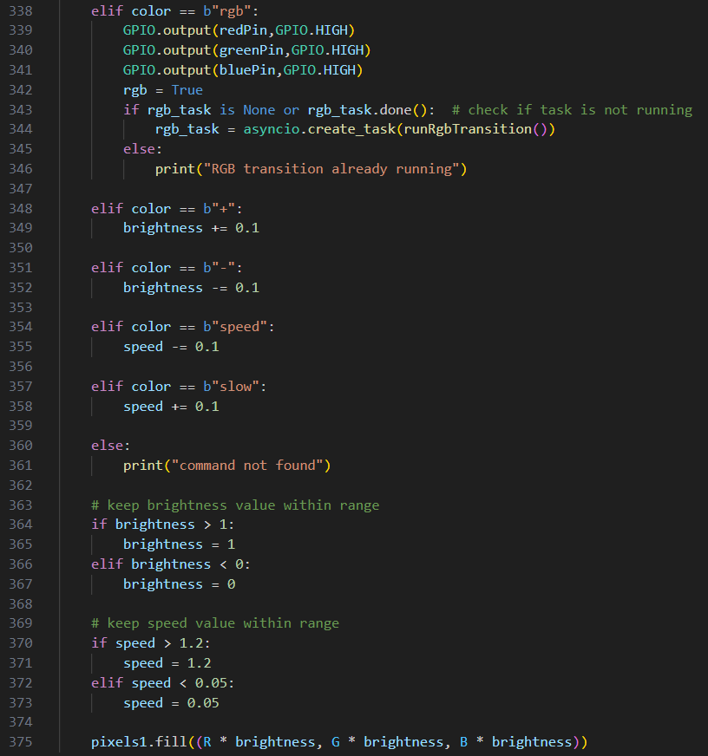
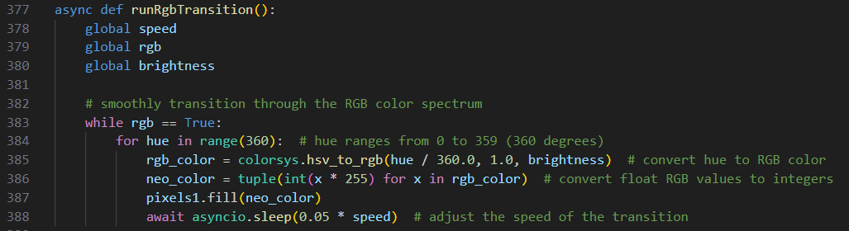
Code [setColor() & RGB]

Slide 9
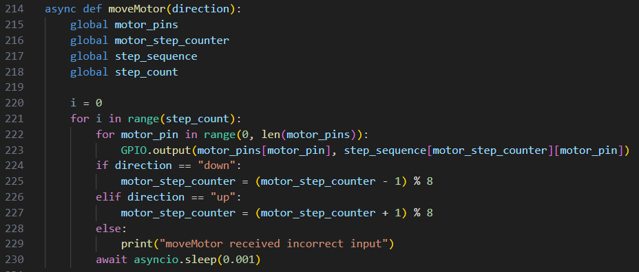
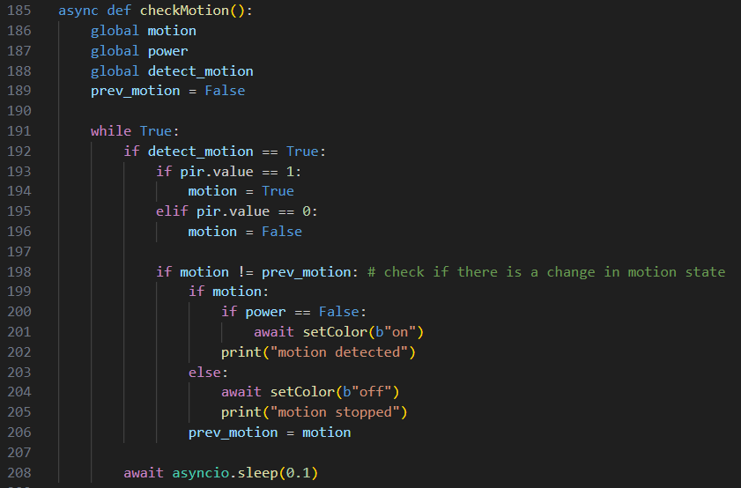
Code [Motor & Motion]

Slide 10
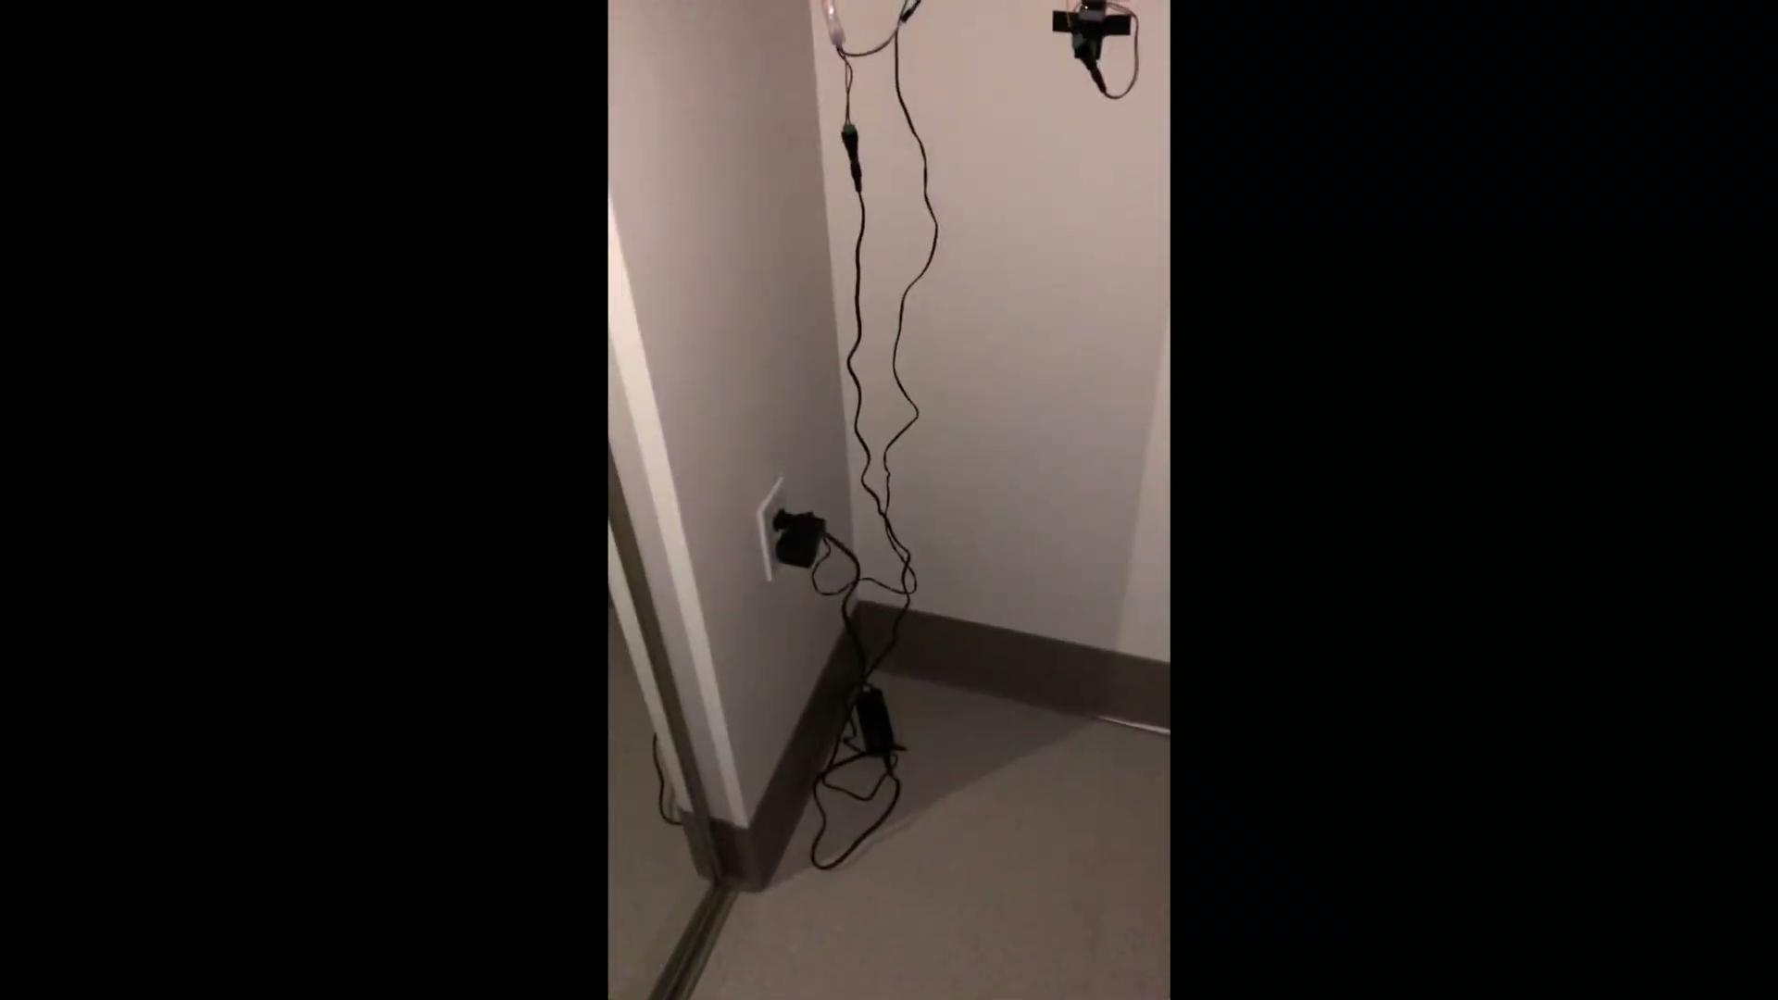

Slide 11
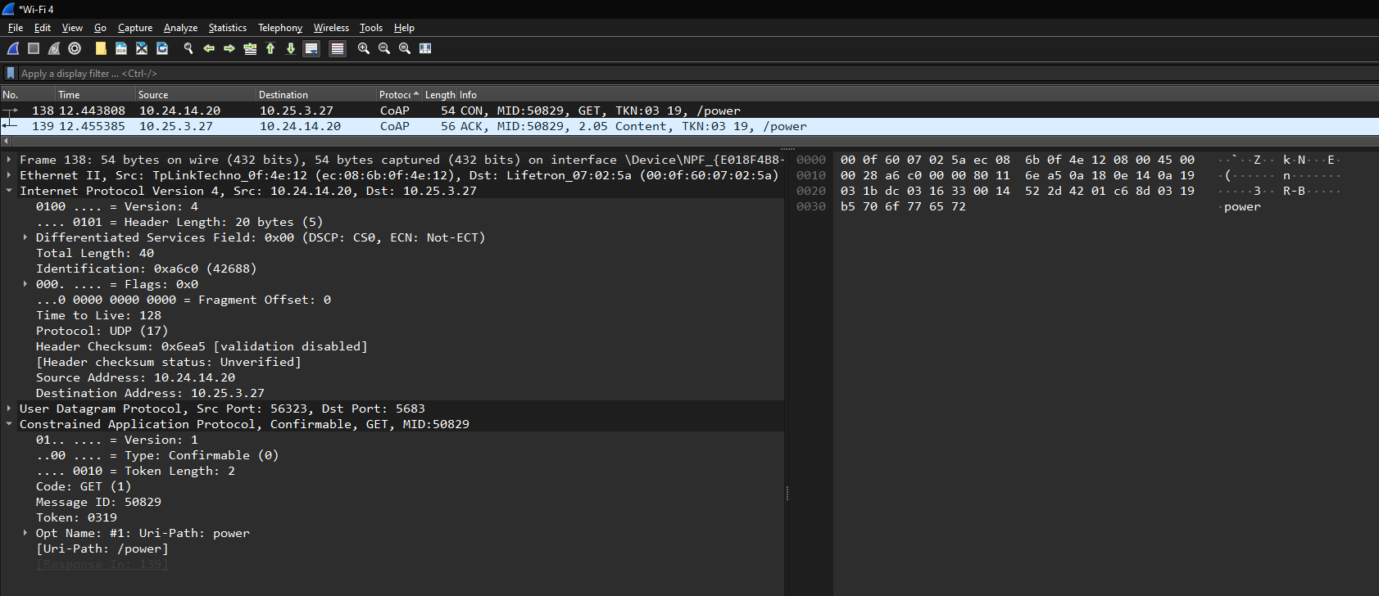
Wireshark Analysis [GET /power]
The client IP sends a GET request to the server’s IP (Raspberry Pi) for the power resource

Slide 12
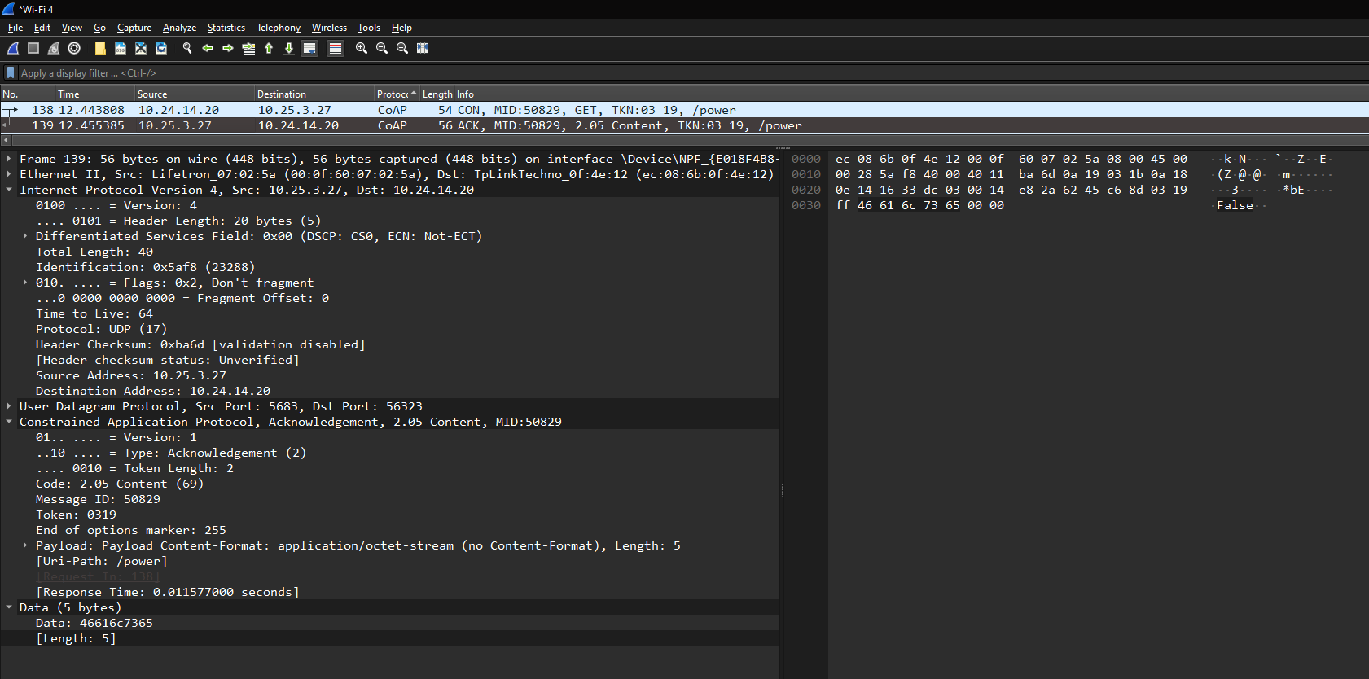
Wireshark Analysis [RECEIVED /power]
The server’s IP sending the payload for the GET request back to the client’s IP

Slide 13
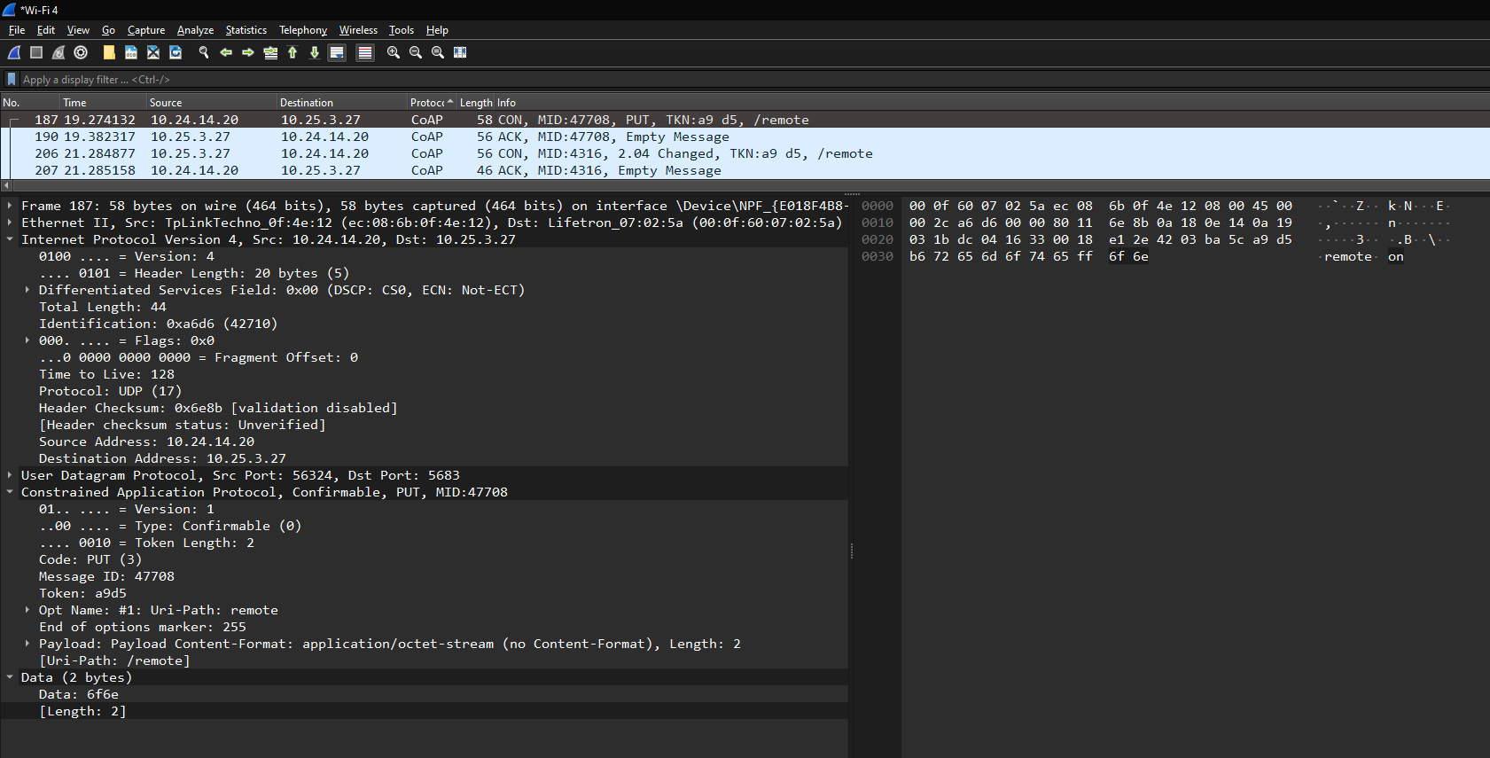
Wireshark Analysis [PUT /remote “on”]
The client sends a PUT request to the server for the “remote” resource to receive the data “on”

Slide 14
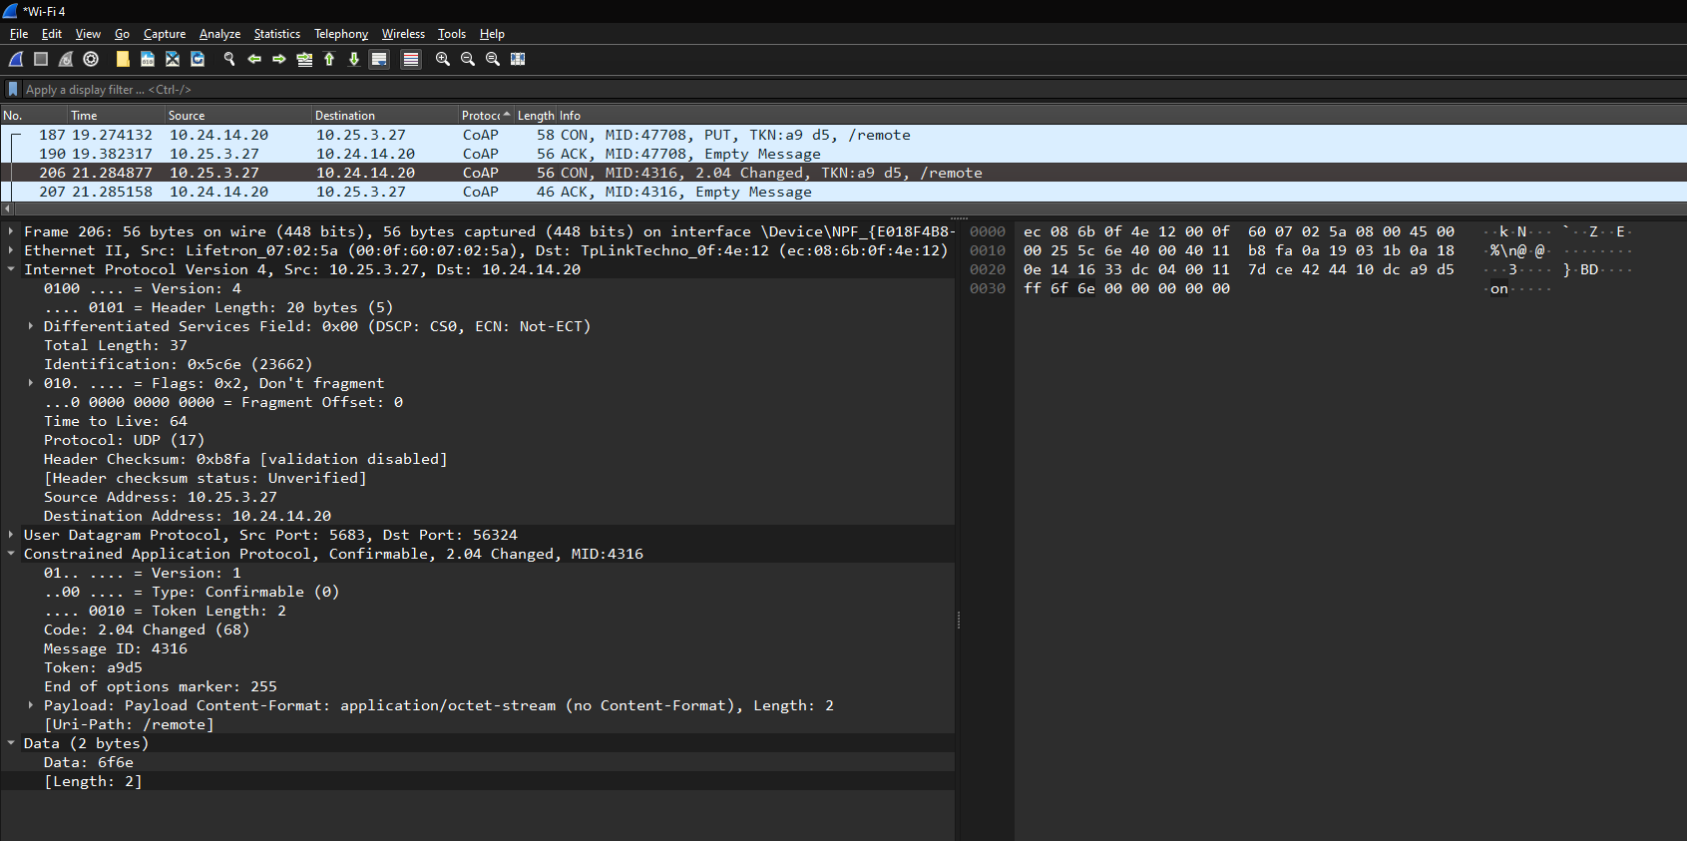
Wireshark Analysis [CHANGED /remote “on”]
The server sends a packet to the client letting the client know that the data they requested to be changed in the “remote” resource has been changed to “on”

Slide 15
Difficulties & Findings
One major difficulty we had was getting all of the functionalities of the sensors/actuators to work together asynchronously without certain functions holding up the entire program
We solved this problem with the asyncio library and its ability to create infinitely looping asynchronous tasks
Another difficulty was getting the PIR motion detector to work with the RPi.GPIO library
It would always detect the motion as true, so we worked around this problem by using the gpiozero library for this sensor. This library made it easier to work with this specific sensor, and it solved our issue.
We found that when controlling a stepper motor, it is much easier to physically setup the ability to control it by using a driver board rather than trying to use it without it

